Slide 1
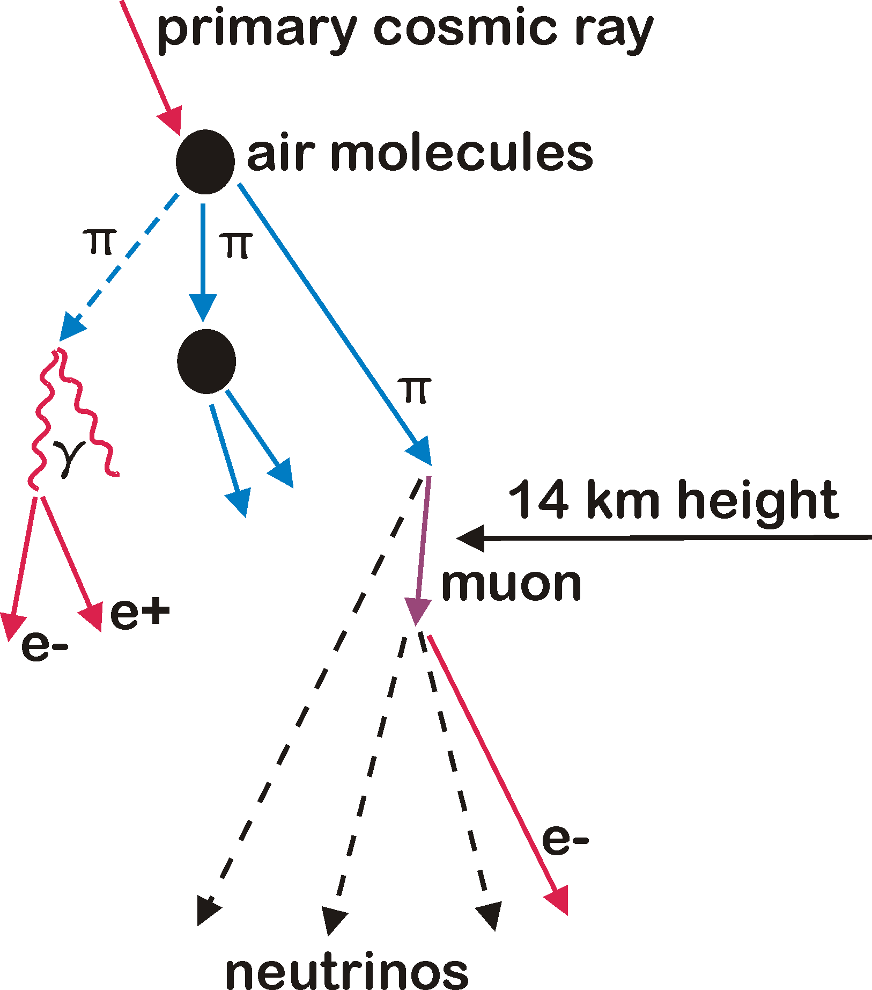
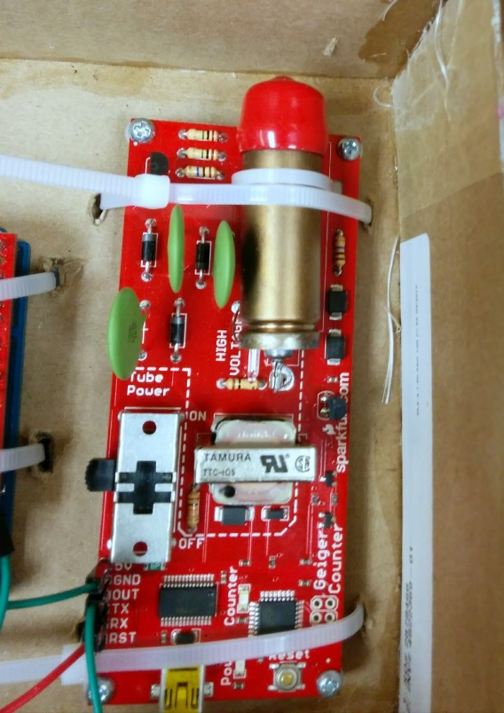
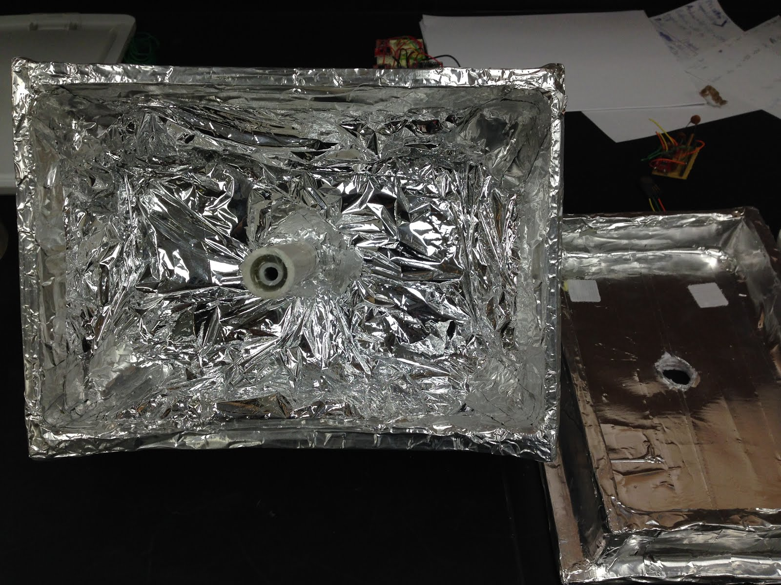
11.5 in
Introduction
Cosmic rays, originating from distant solar flares and supernova, bombard our planet constantly and collide with atomic nuclei at an altitude of 15 kilometers(1). With each of these collisions, a scattering of subatomic particles known as muons are created. Muons posses a mass of 106 MeV and a charge of -1, making them distant cousins to the electron, although with 200 times the total mass(2). Due to their increased mass, muon are unaffected by most matter and are the only cosmic ray particles to reach sea level(2).
We hypothesize that as altitude is increased, the muon flux will increase until we pass the 15 kilometer mark, where the muon flux will then sharply decline.
35.5 in
Fig. 1. Diagram of cosmic rays scattering upon colliding with atmospheric nuclei. The initial pion created on the far right quickly decays into a muon and neutrino at a height of 14 km. The muon then decays into another neutrino and an electron after 2.2 microseconds.
Graphic courtesy of University of Oxford, Department of Physics(3)
Materials and Methods
In order to study how the muon flux varies across altitude, we constructed a small payload box that was designed to ascend to an elevation of 30 kilometers as part of a weather balloon launch.
Constructed out of lightweight foam board and insulated with a combination of fiberglass and Mylar rescue blankets, the payload box was then rigorously tested through various tests designed to evaluate its strength and ability to cope with the -80 degree Celsius temperatures it would experience on ascent.
Once it passed these tests, the box was cleared to be fitted with all of the electronics. To record the muons, a Geiger counter was placed on board, as muons are a form of ionizing radiation. A pressure sensor to calculate the altitude was also added, and the box was ready for launch.
Fig. 2. Photo of Geiger counter used. The small tube at the top contains two electrodes and an inert gas. Ionizing radiation briefly charges the gas, completed the circuit and registering as a single count.
Fig. 3. View of the interior of a completed payload box, minus all electronics. The Mylar rescue blanket is clearly visible, along with aluminum tape along the exterior of the box.

Slide 2
11.5 in
Conclusions
Although the high altitude launch is set to take place after our program here at FSI, we were able to test our hypothesis in regards to the expedition to Rocky Mountain National Park. The data supports our hypothesis in regards to the muon flux increasing with altitude, as the counts per minute taken at 1,400 meters were much lower than the counter per minute at the maximum altitude experienced at 3,800 meters.
Unfortunately, it was impossible to test the second half of our hypothesis, as there was not a weather balloon launch in time to publish our findings. However, it remains likely that our hypothesis is correct, although further experimentation is required.
Muons are one of the only forms of cosmic ray radiation that actual survive long enough to reach the surface of the planet. As they are an ionizing type of radiation, they hold the possibility of causing mutations in the DNA of life forms down below, both beneficial and harmful. We need to understand more about how muons function and effect us as a species in order to grasp the possible implications of those living or working at higher elevations. Additionally, muons may be usable as a new measure of altitude if enough data on the muon flux across various altitudes is compiled.
35.5 in
Literature cited
(1.)Liu, L., & Solis, P. (2007, November 18). The Speed and Lifetime of Cosmic Ray Muons. Retrieved July 17, 2014, from http:// web.mit.edu/lululiu/Public/pixx/not-pixx/muons.pdf
(2.) Cosmic Ray Muons and the Muon Lifetime. (2013, October 14). Retrieved July 17, 2014, from http://www.phys.ufl.edu/courses/phy4803L/group_I/muon/muon.pdf
(3.) Cobb, J. H., & Achenbach, P. (2001, May 14). The Airborne Detector for low Energy cosmic Rays. .Retrieved July 19, 2014, from http://www.physics.ox.ac.uk/neutrino/HAMF/ADLER%20Home%20Page.htm
Acknowledgments
We wish to extend a hearty thanks to Matthew Semak, David Garrett, Amber Bekalli and Maurice Woods, who mentored and taught us everything that we needed to know in order to complete this project. We also wish to thank the Frontiers of Science Institute and the efforts of Lori Ball to give us this excellent opportunity. We thank AAVSO for supplying the weather balloon and GPS materials for the actual launch on August 2nd, 2014. Finally, we wish to thank the Adolph Coors Foundation and Excel Energy for provided the necessary funds for this endeavor, and for their investment in the young minds of the future.
For further information
To learn more about this project, contact jagerecht@gmail.com or mwinchester26@gmail.com More information on this can also be obtained at http://fsi2014ballonpayload.weebly.com
and http://winchesterfsi2014.weebly.com.

