Slide 1
Analysis of Muon Flux Across Altitude
By Jacob Gerecht and Michael Winchester

Slide 2
What are Muons?
Sub-atomic particles
Cousins of electrons
A form of cosmic radiation
Particle: | Mass: | Charge: | Lifetime:
Electron | 0.511 MeV | -1 | NA
Muon | 106 MeV | -1 | 2.2 microseconds

Slide 3
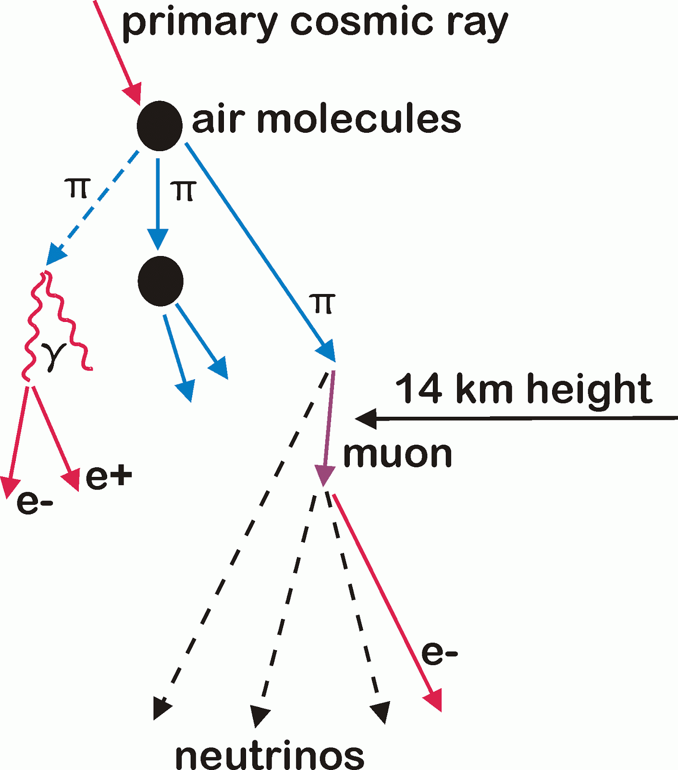
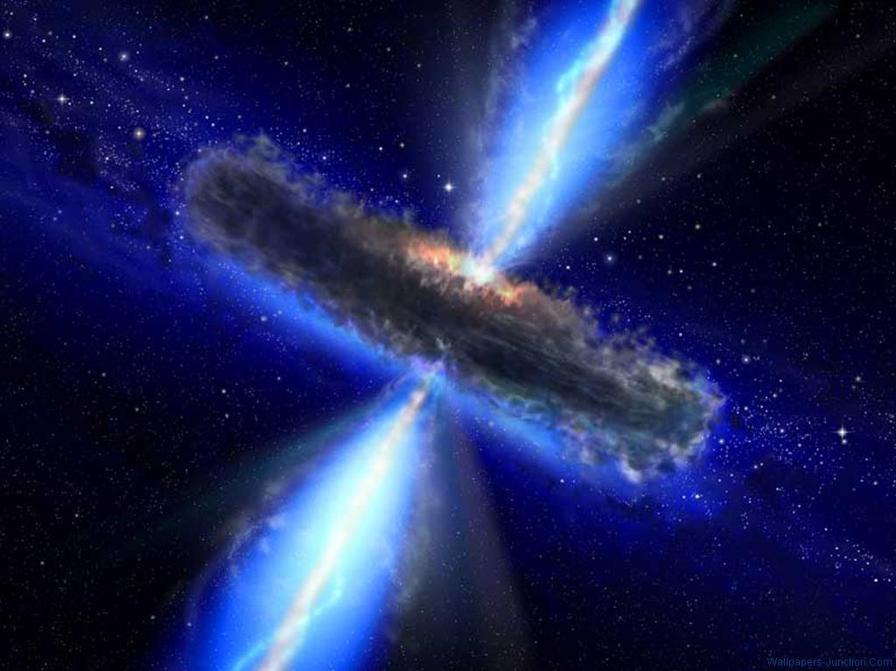
Where do Muons Come From?
Cosmic Rays
Creation of Pions
Decay into Muon + neutrino

Slide 4
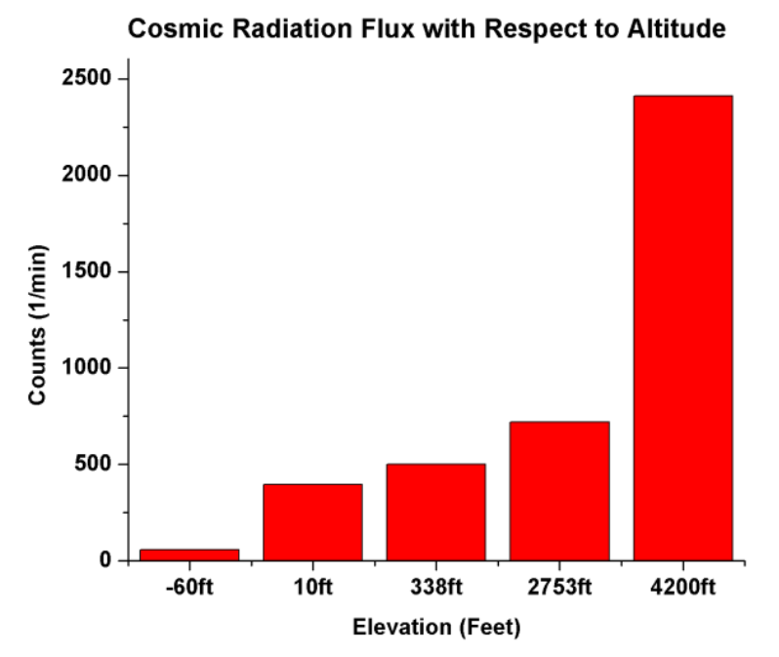
Muon Flux
# of muon occurrences
Sea level
1 muon per cm², per minute, per steradian
What about upper elevations?
Graph courtesy of Ramesh, N., Hawron, M., Martin, C., & Bachri, A. (2011, January 1). Flux Variation of Cosmic Muons. Retrieved July 18, 2014, from http://arxiv.org/pdf/1203.0101.pdf

Slide 5
The Experiment
Weather balloon payload
30 kilometers
Hypothesis
Increase with altitude
Sharp decrease past 15 kilometers

Slide 6
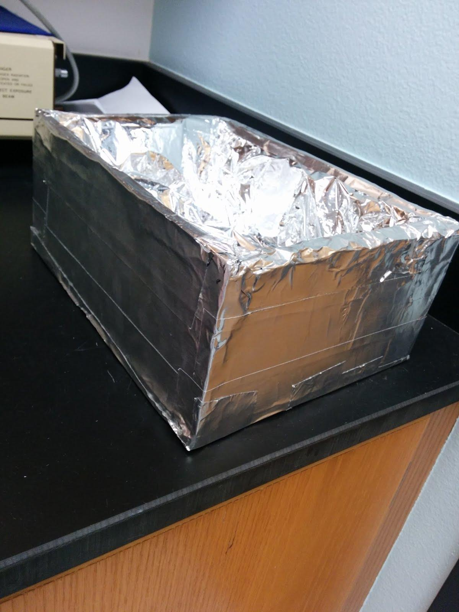
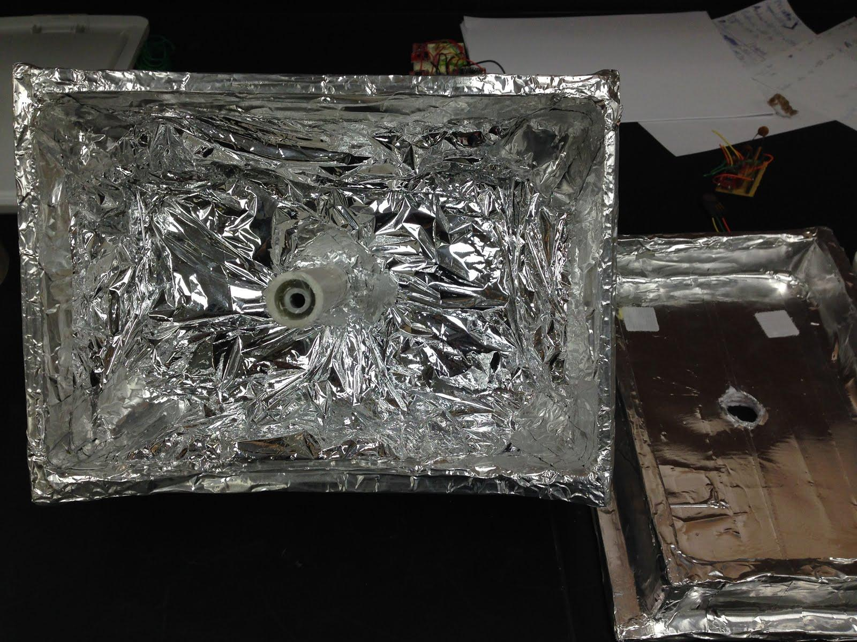
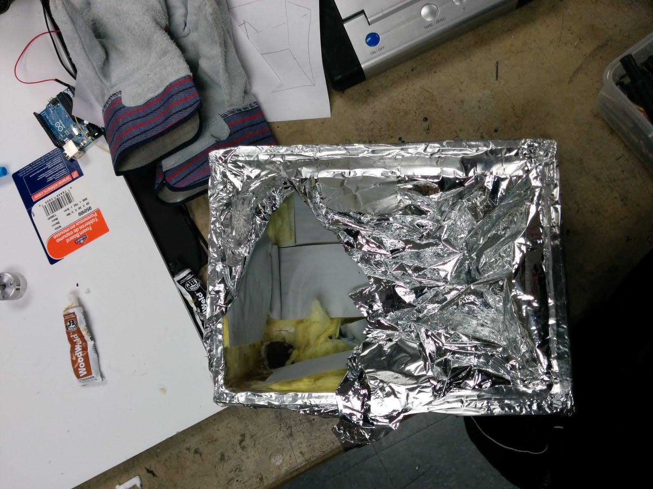
Methods
Building the Module

Slide 7
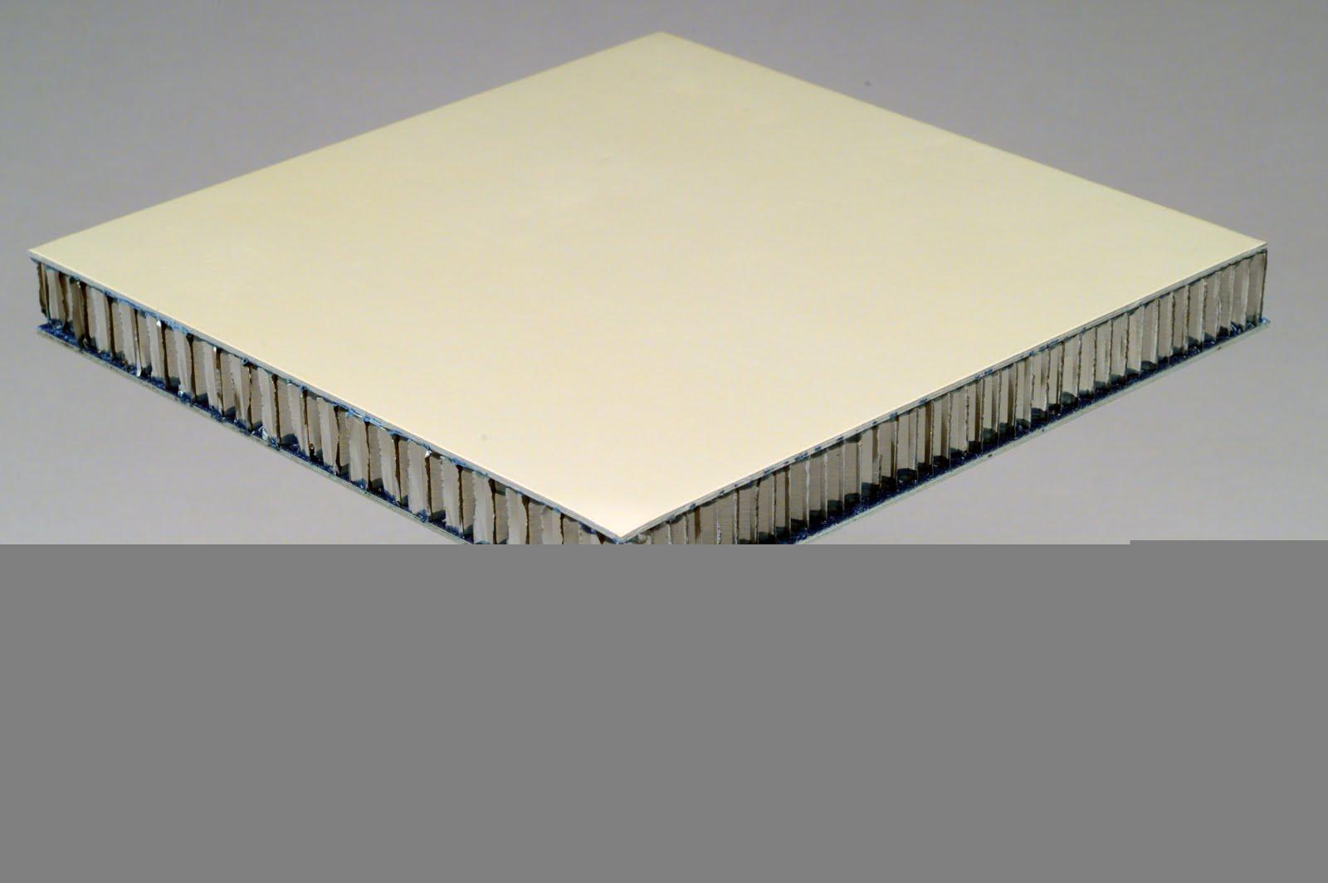
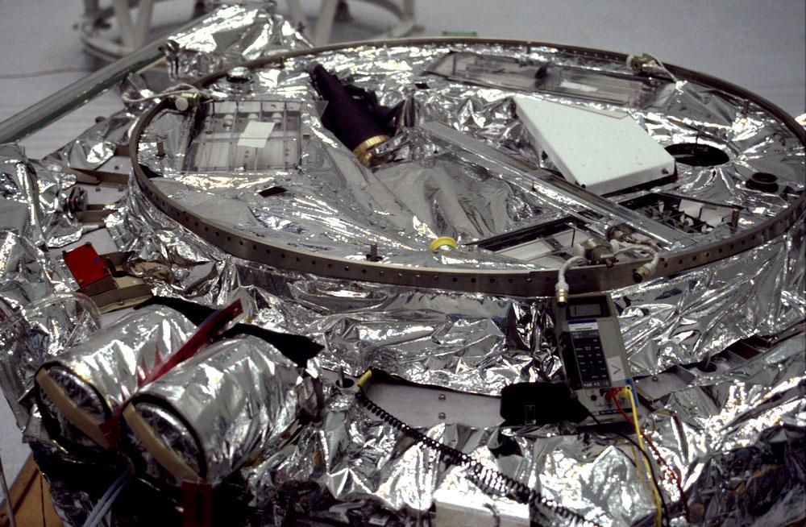
Hardware
FoamCore
Fiberglass insulation
Mylar rescue blanket
Aluminum tape

Slide 8
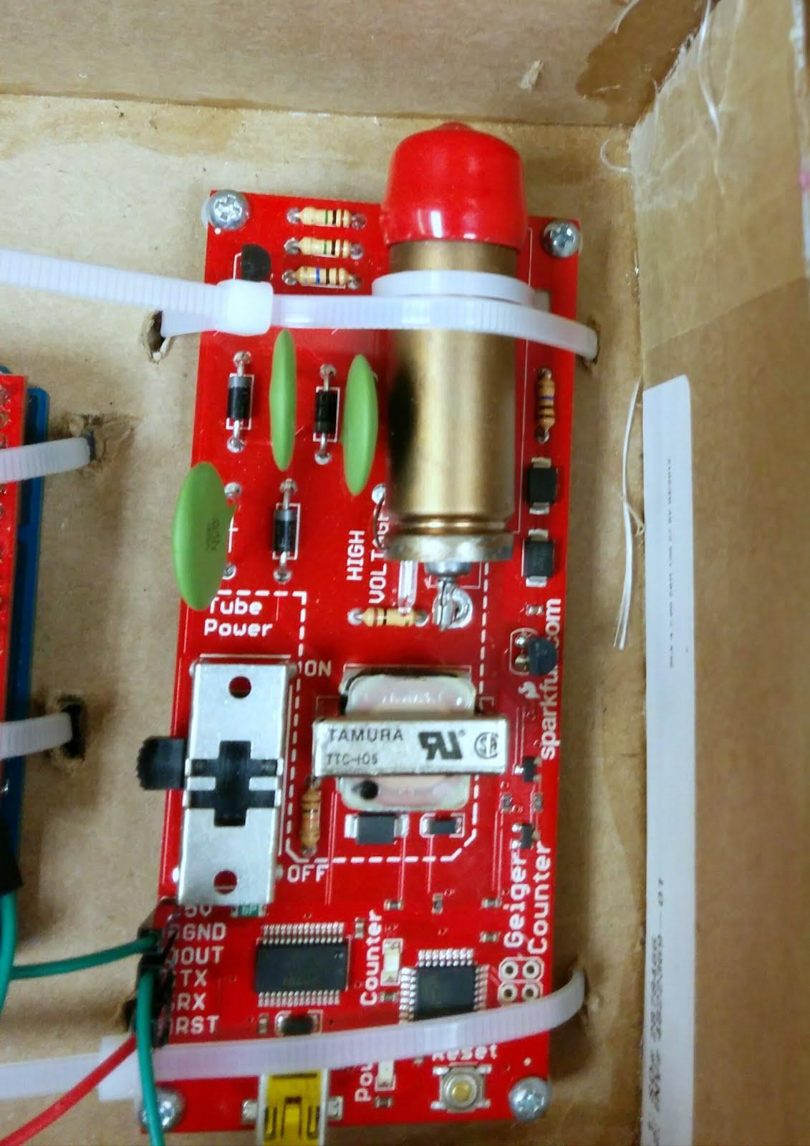
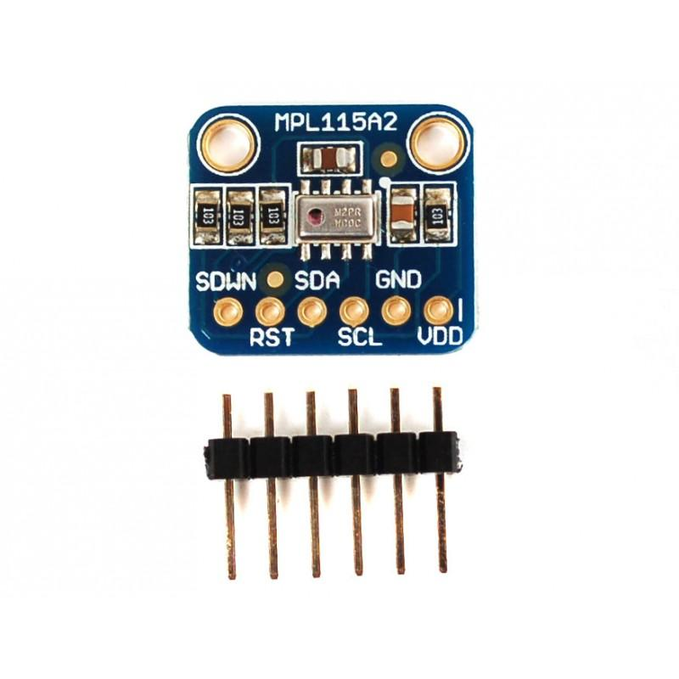
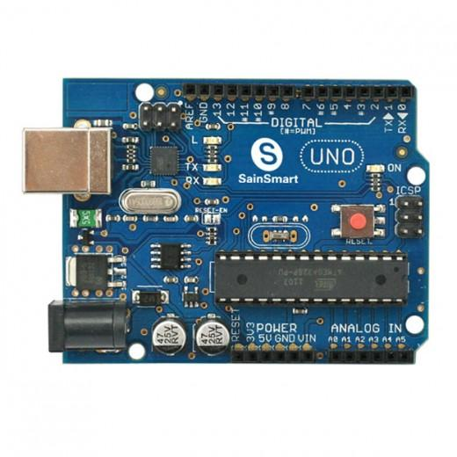
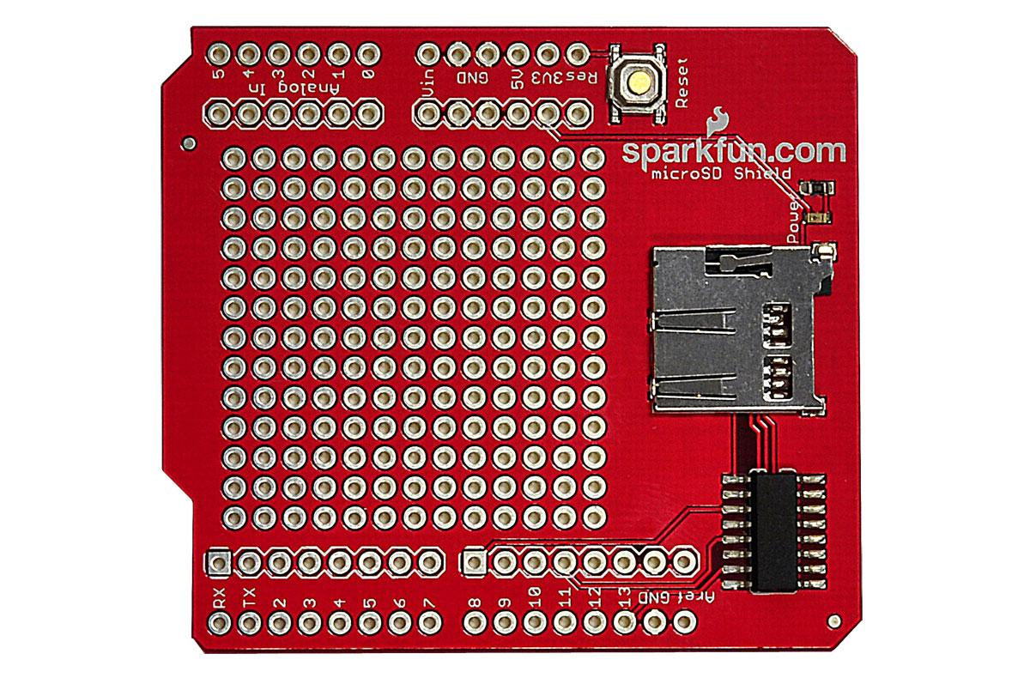
Electronics
Geiger counter
VMP 180 sensor
Temperature and Pressure
Arduino
Micro SD shield

Slide 9
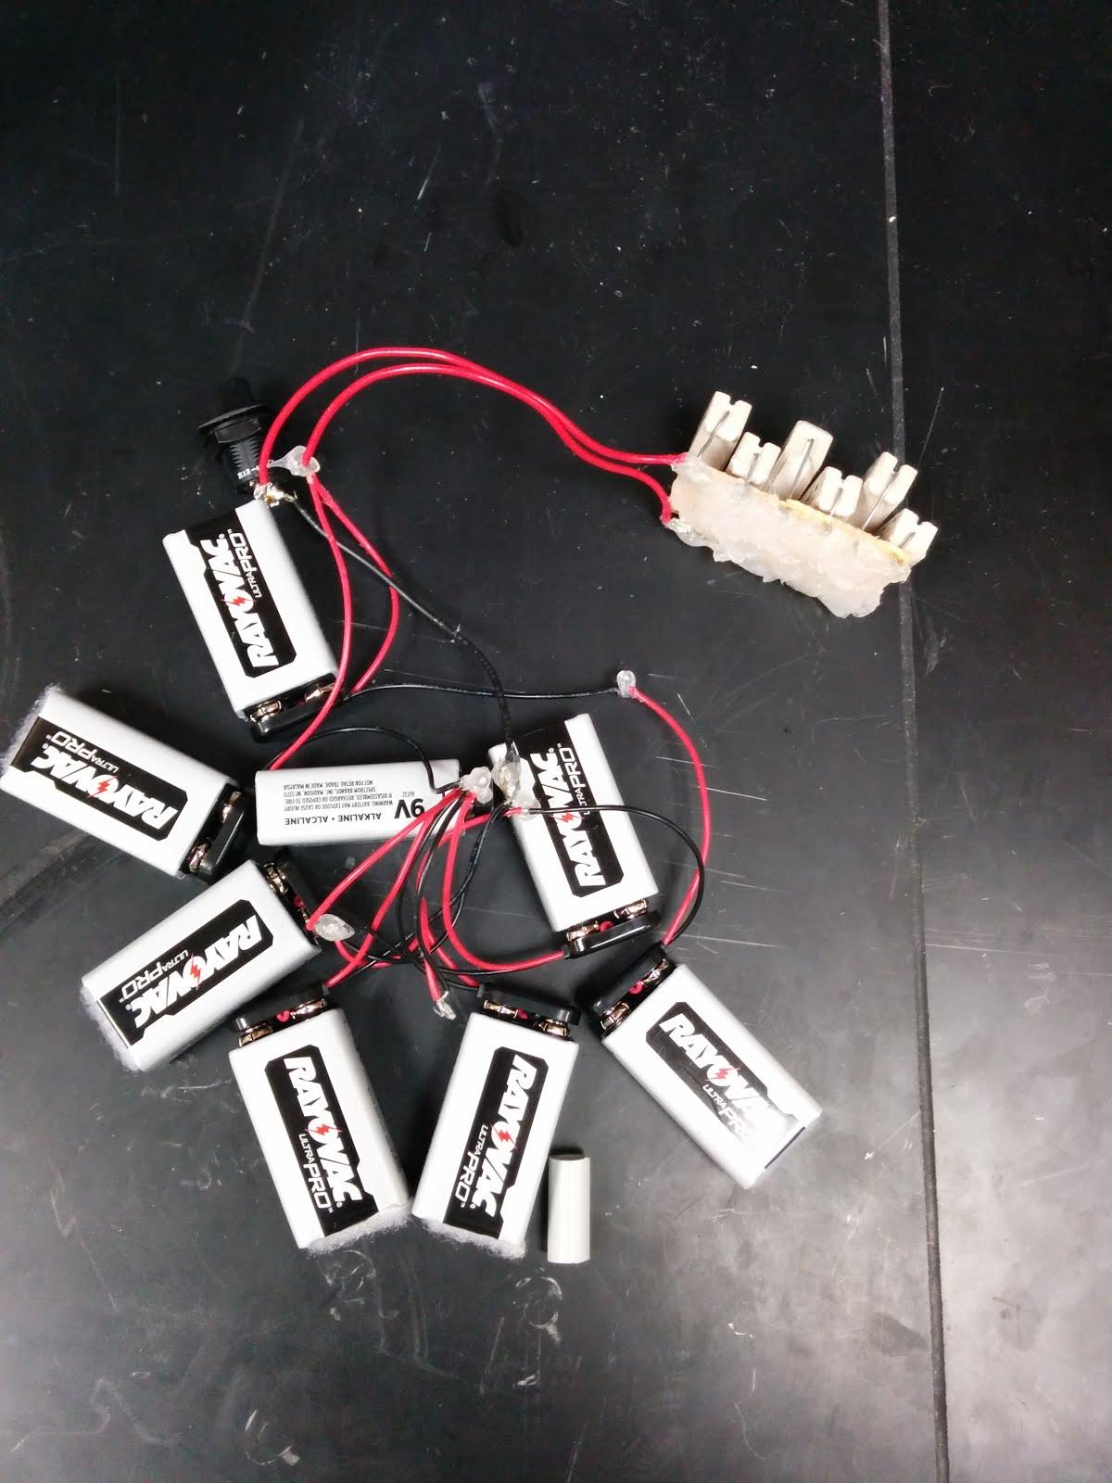
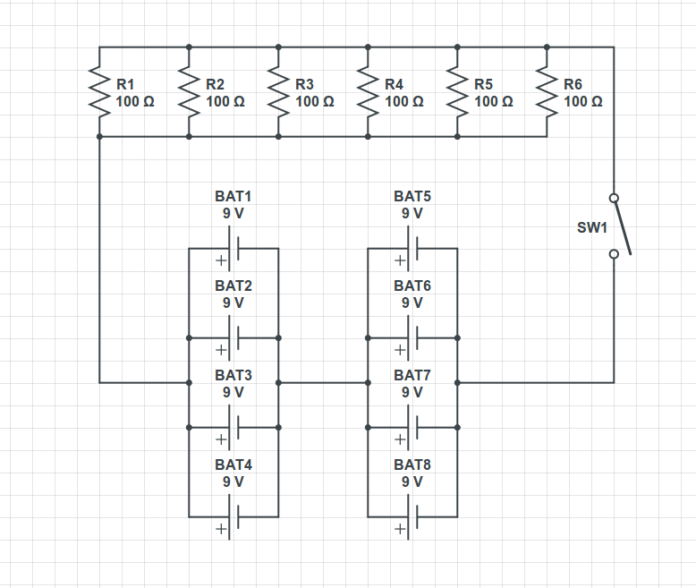
Heating the Module
1 kOhm power resistors (6x)
9V batteries (8x)
On-off switch

Slide 10
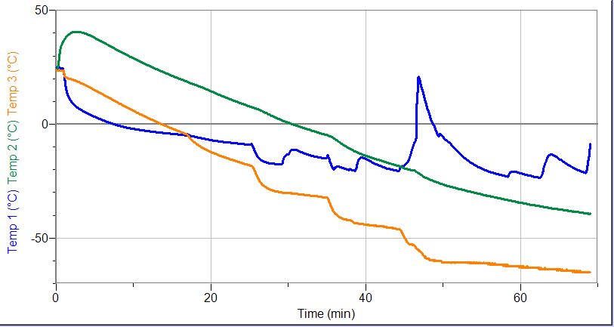
Testing the Module
Whip Test
-Can payload handle turbulence?
Drop Test
-Can payload handle impact?
Elevator Test
-Can instruments collect data properly?
Temperature Test
-Can heater provide sufficient heat?

Slide 11
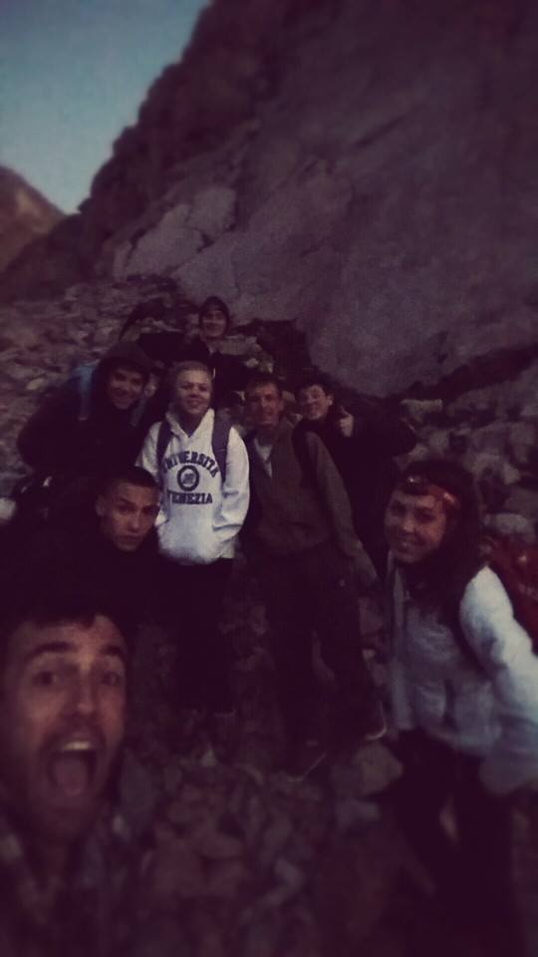
Obtaining the Data
Spearhead Peak
Hike from 1,500 m to 3,600 m
Record all geiger counter data
during ascent

Slide 12
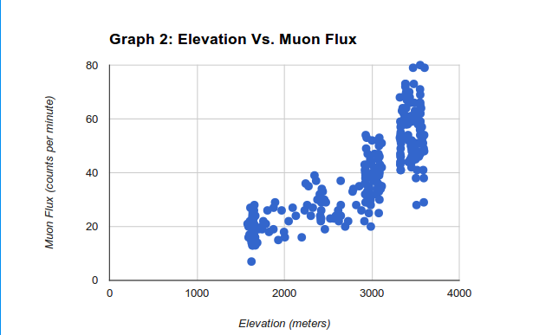
Data

Slide 13
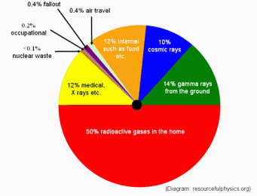
Implications
Ionizing radiation
Mutations
Energy Source?
Image courtesy of resorcefulphysics.org

Slide 14
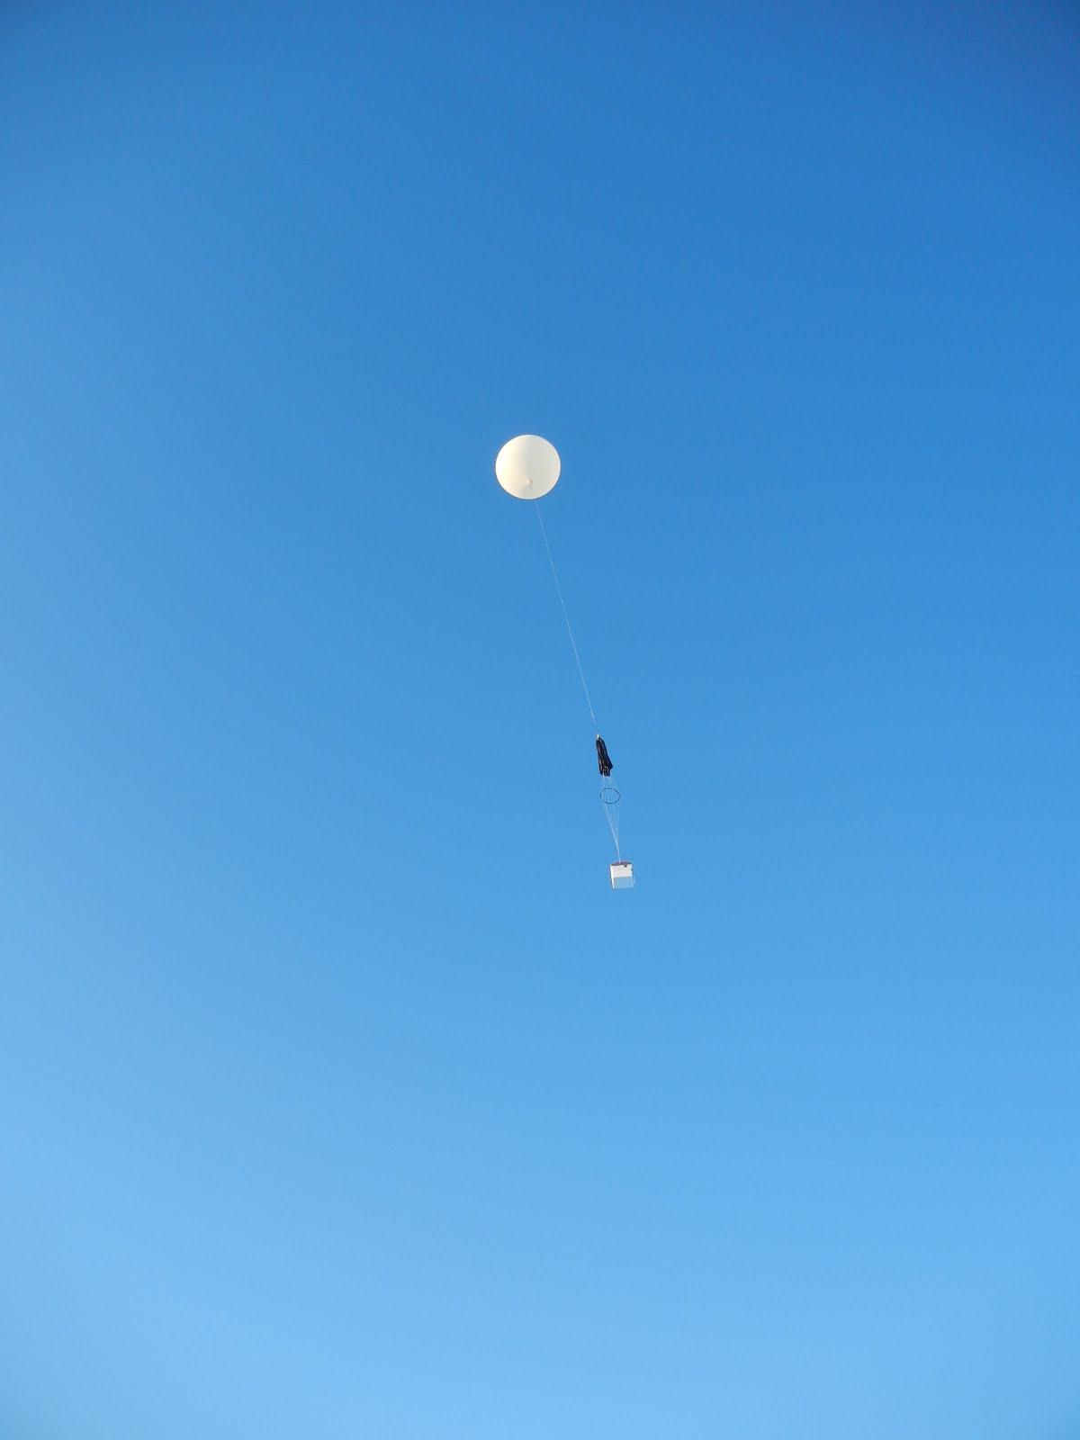
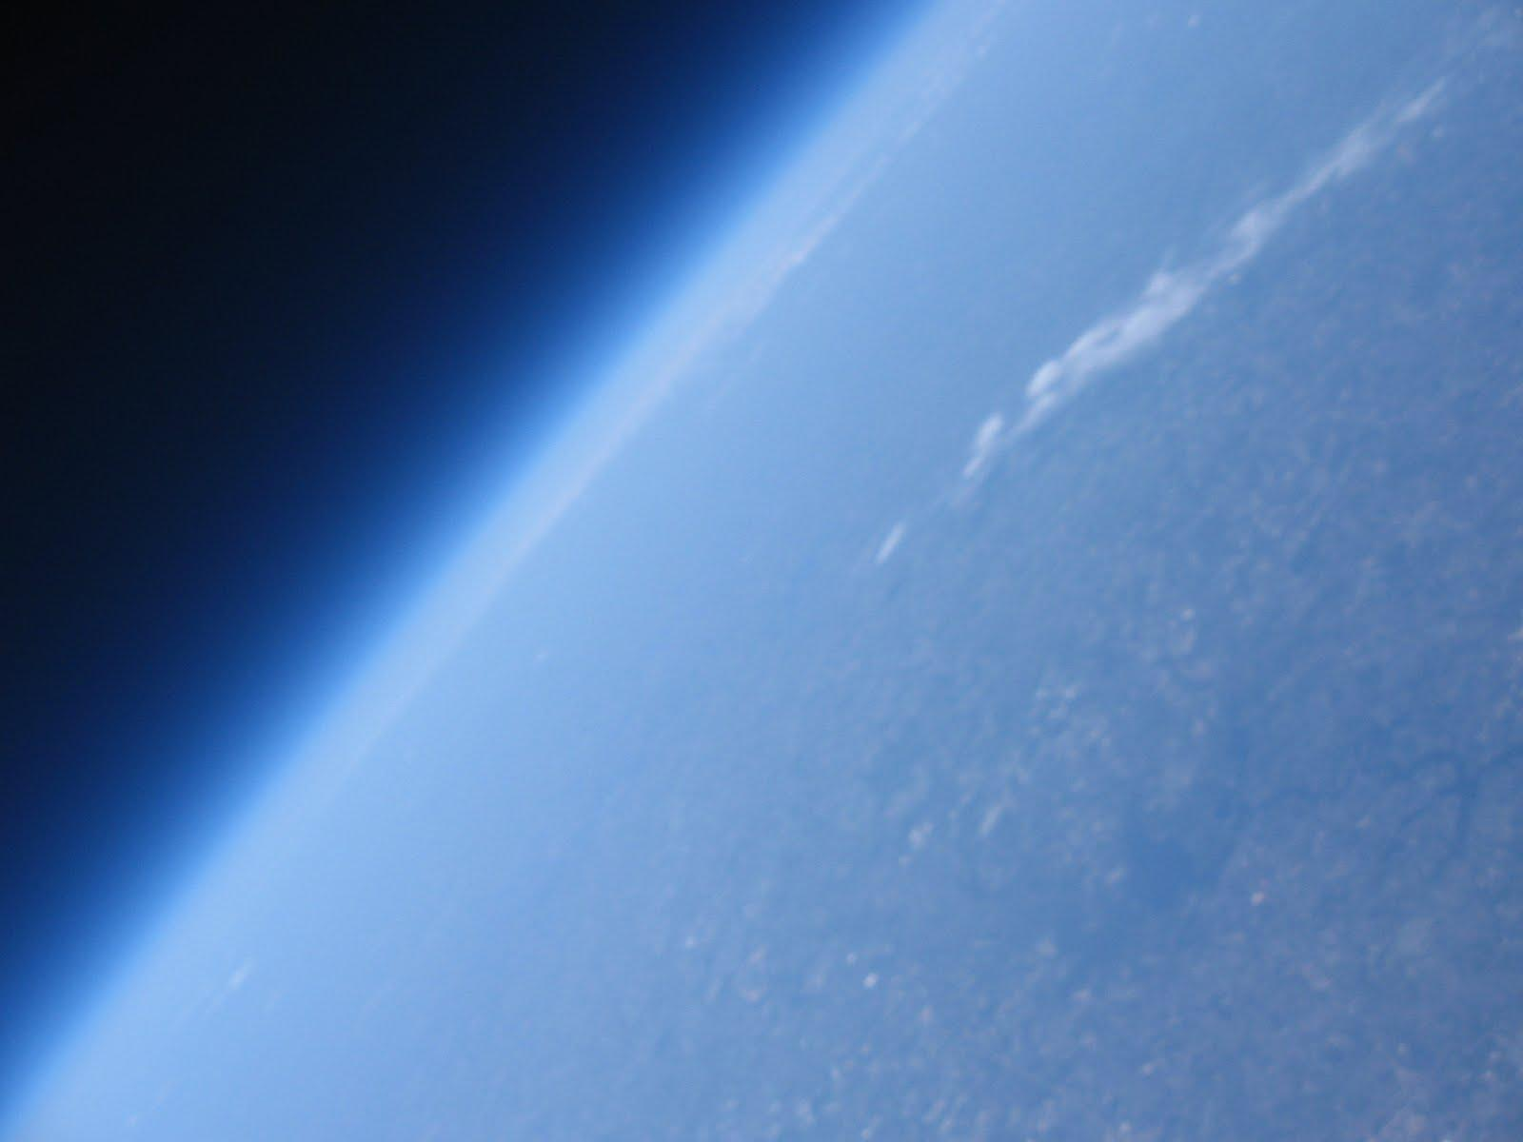
The Next Step
Demo-SAT launch
30 kilometers peak altitude

Slide 15
References
(1.) Cosmic Ray Muons and the Muon Lifetime. (2013, October 14). Retrieved July 17, 2014, from http://www.phys.ufl.edu/courses/phy4803L/group_I/muon/muon.pdf
(2.) Liu, L., & Solis, P. (2007, November 18). The Speed and Lifetime of Cosmic Ray Muons. Retrieved July 17, 2014, from http://web.mit.edu/lululiu/Public/pixx/not-pixx/muons.pdf
(3.) Schirber, M. (2009, August 27). Death Rays From Space: How Bad Are They? Retrieved July 17, 2014, from http://www.space.com/7193-death-rays-space-bad.html
(4.)Muon basics. (n.d.). . Retrieved July 17, 2014, from http://www2.fisica.unlp.edu.ar/~veiga/experiments.html#mass
(5.) U.s. standard atmosphere. In (2012). W. Haynes (87 Ed.), CRC Handbook of Chemistry and Physics (pp. 14-19, 14-25). Retrieved from http://www.hbcpnetbase.com/
(6.)Ramesh, N., Hawron, M., Martin, C., & Bachri, A. (2011, January 1). Flux Variation of Cosmic Muons. Retrieved July 18, 2014, from http://arxiv.org/pdf/1203.0101.pdf

Slide 16
Acknowledgements
We’d like to thank Matthew Semak for all his tremendous help on this project. He, David, and Amber were all excellent mentors to aid and teach us. They always answered any questions we had during the research process, and stuck with us till the end. We would like to thank Amber, David, and Maurice for their help on this presentation and research paper. Our best regards go out to Lori Ball and UNC, for maintaining a program as awesome as FSI. We’d like to thank the entire staff of FSI as well as, the R.A.s, and the teachers. We also would like to thank all of the sponsors and families who helped make this program possible.

